Slide 1

#LifeKoKaroLift
Bike Sharing Assignment

Slide 2



Course : Machine Learning
Lecture On : Bike Sharing Pre-assignment
Instructor : Sanjay Pandey

Slide 3


Slide 4
Today’s Agenda
Problem Statement walkthrough
The objectives for the assignment
Pre-Modelling Steps
Model Building
Model Evaluation
Q & A

Slide 5

Bike Sharing Assignment
What is BoomBikes ?
A bike-sharing system in which bikes are made available for shared use to individuals on a short term basis for a price or free. It allow people to borrow a bike from a "dock" which is usually computer-controlled wherein the user enters the payment information, and the system unlocks it. This bike can then be returned to another dock belonging to the same system.
Business objective: The objective is to model the demand for shared bikes with the available independent variables. It will be used by the management to understand how exactly the demands vary with different features. They can accordingly manipulate the business strategy to meet the demand levels and meet the customer's expectations. Further, the model will be a good way for management to understand the demand dynamics of a new market.

Slide 6



















Bike Sharing Assignment
Requirements
Which variables are significant in predicting the demand for shared bikes.
How well those variables describe the bike demands.
What you need to do?
Create a linear model that describe the effect of various features on demand.
Th model should be interpretable so that the management can understand it.

Slide 7














Bike Sharing Assignment
Assignment Steps
Identify different variable types
Drop Unnecessary variables: ex. ‘instant’ , ‘dteday’ , ‘casual’ and ‘registered’ etc.
Make necessary changes as per the different features
DEMAND DATA “day.csv”
instant | dteday | season | yr | mnth | holiday | weekday | workingday | weathersit | temp | atemp | hum | windspeed | casual | registered | cnt
1 | 01-01-2018 | 1 | 0 | 1 | 0 | 6 | 0 | 2 | 14.11 | 18.181 | 80.6 | 10.749882 | 331 | 654 | 985
2 | 02-01-2018 | 1 | 0 | 1 | 0 | 0 | 0 | 2 | 14.9 | 17.687 | 69.6 | 16.652113 | 131 | 670 | 801
3 | 03-01-2018 | 1 | 0 | 1 | 0 | 1 | 1 | 1 | 8.051 | 9.4703 | 43.7 | 16.636703 | 120 | 1229 | 1349
4 | 04-01-2018 | 1 | 0 | 1 | 0 | 2 | 1 | 1 | 8.2 | 10.606 | 59 | 10.739832 | 108 | 1454 | 1562
5 | 05-01-2018 | 1 | 0 | 1 | 0 | 3 | 1 | 1 | 9.305 | 11.464 | 43.7 | 12.5223 | 82 | 1518 | 1600
6 | 06-01-2018 | 1 | 0 | 1 | 0 | 4 | 1 | 1 | 8.378 | 11.66 | 51.8 | 6.0008684 | 88 | 1518 | 1606

Slide 8














Bike Sharing Assignment
Assignment Steps
Data Visualization
Perform EDA to understand various variables.
Check the correlation between the variables.
Data Preparation
Create dummy variables for all the categorical features.
Divide the data to train & Test.
Perform Scaling.
Divide data into dependent & Independent variables.
Data Modelling & Evaluation
Create Linear Regression model using mixed approach (RFE & VIF/p-value).
Check the various assumptions.
Check the Adjusted R-Square for both train & Test data.
Report the final model.

Slide 9
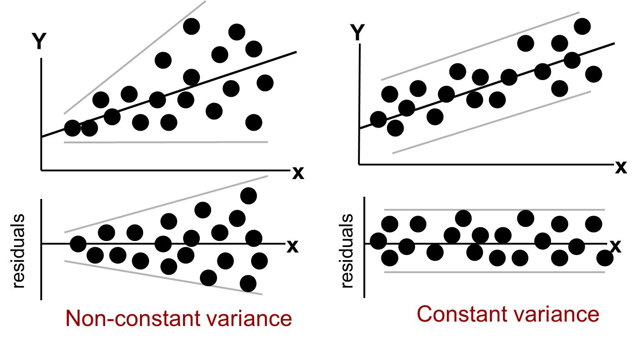
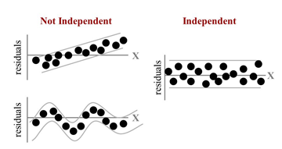








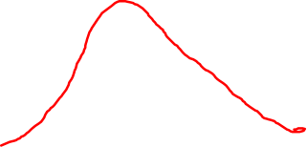








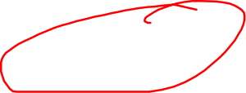









Assumptions for residual analysis
Normality of Error
Error values (ε) are normally distributed for any given value of X
Homoscedasticity
The probability distribution of the errors has constant variance
Independence of Errors
Error values are statistically independent

Slide 10


















Slide 11






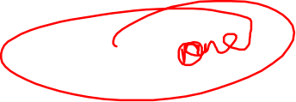
















Slide 12

Subjective Questions
Steps to complete the subjective answers
Answer all the questions.
For subjective answers, use DOC file. If you wish to add images you can. But convert the document to PDF format before submitting.
You can use images and plots to support your answers.
Make sure the question is answered in a concise and effective manner: No word limit
Please do not copy from online available literature. You are free to refer any resources. Write the answers in your own words

Slide 13



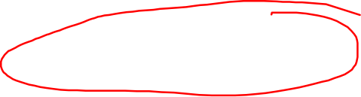




End note
Tips
Add comments/observations after every cell of code. So that we can understand your approach and method.
Describe the results
Create only once Jupyter Notebook.
Submit once zip file with the code and the PDF
Use stack Overflow
Post on the discussion forums for resolving any doubts
Finally, Write the code manually instead of copy-pasting from the in-content notebooks provided. It's fine to look and write

Slide 14

#LifeKoKaroLift
Thank You!

Slide 15



Descriptive Statistics
“ A descriptive statistic is a summary statistic that quantitatively describes or summarizes features of a collection of information. “
Measurement level of Data
Cardinal Numbers
A Cardinal Number says how many of something there are, such as one, two, three ..
It answers the question "How Many?“ , Example: here are five coins
Ordinal Numbers
An Ordinal Number tells us the position of something in a list.1st, 2nd, 3rd, 4th, 5th and so on, eg: Grades, Star Reviews, Position in Race, Date
Nominal Numbers
A Nominal Number is a number used only as a name, or to identify something (not as an actual value or position) eg: Brand Name, ZipCode, Gender

Slide 16
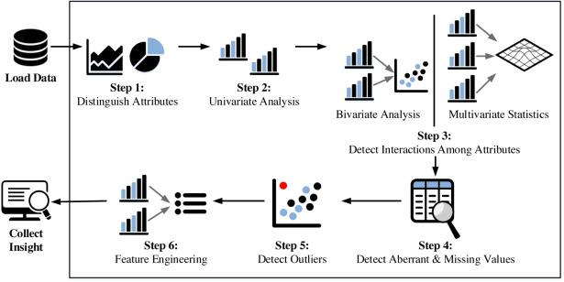
Fundamental steps of EDA process

Slide 17
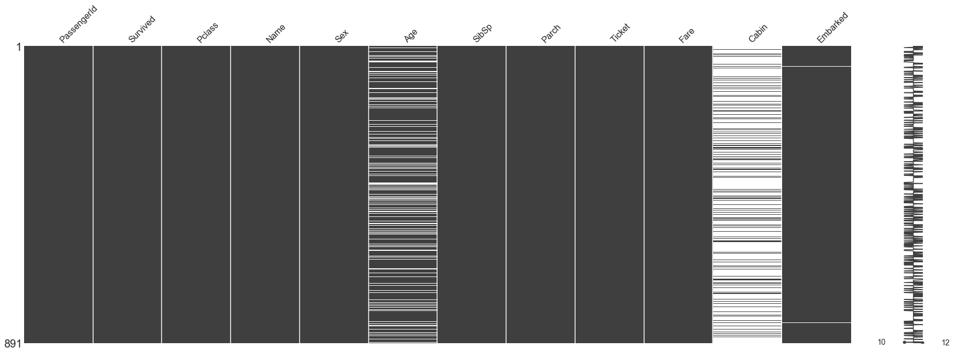
Missing Value Treatment
Data Extraction: It is possible that there are problems with extraction process. In such cases, we should double-check for correct data with data guardians. Some hashing procedures can also be used to make sure data extraction is correct. Errors at data extraction stage are typically easy to find and can be corrected easily as well.
Data collection: These errors occur at time of data collection and are harder to correct. They can be categorized in four types:

Slide 18

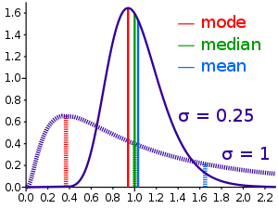
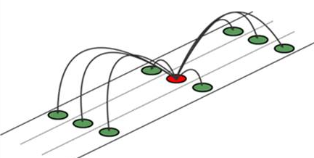
Methods to treat missing values
Data – deletion Deletion methods are used when the nature of missing data is “Missing completely at random” or we have good amount of data and the data loss would be really low ,else non-random missing values can bias the model output
Mean/ Mode/ Median Imputation Mean / Mode / Median imputation is one of the most frequently used methods. It consists of replacing the missing data for a given attribute by the mean or median (quantitative attribute) or mode (qualitative attribute) of all known values of that variable.
Prediction Model we create a predictive model to estimate values that will substitute the missing data. In this case, we divide our data set into two sets: One set with no missing values for the variable and another one with missing values. First data set become training data set of the model while second data set with missing values is test data set and variable with missing values is treated as target variable.

Slide 19
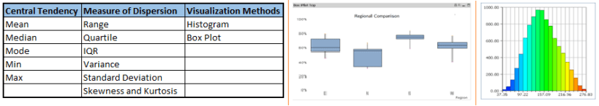
Univariate Analysis
At this stage, we explore variables one by one. Method to perform univariate analysis will depend on whether the variable type is categorical or continuous.

Slide 20
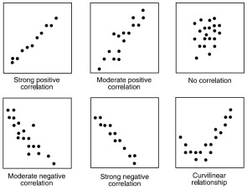
Continuous vs continuous
While doing bi-variate analysis between two continuous variables, we should look at scatter plots. It is a nifty way to find out the relationship between two variables. The pattern of scatter plot indicates the relationship between variables. The relationship can be linear or non-linear.

Slide 21
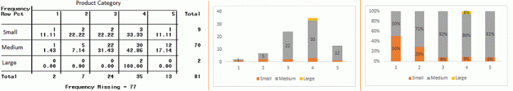
Categorical & Categorical
Two-way table: We can start analyzing the relationship by creating a two-way table of count and count%. The rows represents the category of one variable and the columns represent the categories of the other variable. We show count or count% of observations available in each combination of row and column categories.
Stacked Column Chart: This method is more of a visual form of Two-way table.

Slide 22
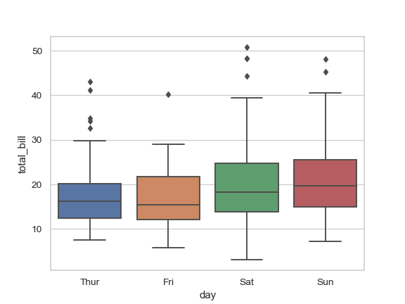
Categorical & continuous
While exploring relation between categorical and continuous variables, we can draw box plots for each level of categorical variables

Slide 23
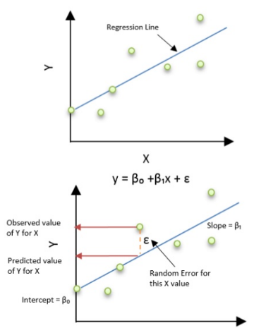
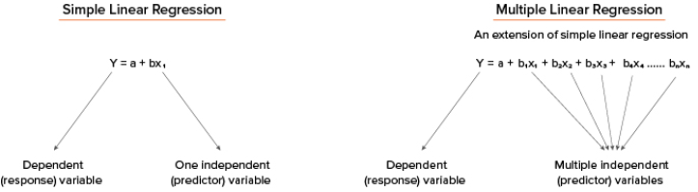
Linear Regression
What Is Linear Regression?
It is the simplest form of regression. It is a technique in which the dependent variable is continuous in nature. The relationship between the dependent variable and independent variables is assumed to be linear in nature.
Simple linear regression, gets its adjective ‘simple’, because it concerns the study of only one predictor variable, similarly multiple linear regression concerns the study of two or more predictor variables.

Slide 24
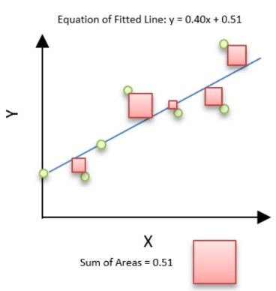


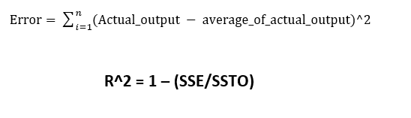


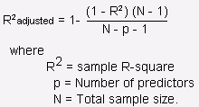

Linear Regression
Residual sum of squares (RSS)
This gives information about how much the target value varies around the regression line (predicted value).
The best-fit line is obtained by minimizing a quantity called Residual Sum of Squares (RSS) which could be optimized using Gradient Descent to get parameters of the best fit line.
Total sum of squares (TSS)
This tells how much the data point move around the mean.
R-squared is a statistical measure of how close the data are to the fitted regression line. It is also known as the coefficient of determination

Slide 25
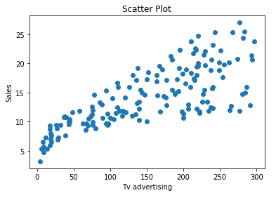
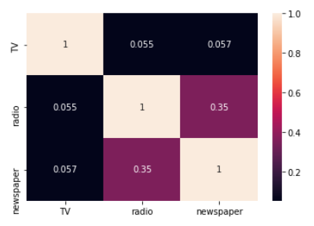
Assumptions of Linear Regression
Assumptions of Linear Regression
Linear Relationship between the features and target
According to this assumption there is linear relationship between the features and target. Linear regression captures only linear relationship. This can be validated by plotting a scatter plot between the features and the target.
Little or no Multicollinearity between the features
Multicollinearity is a state of very high inter-correlations or inter-associations among the independent variables. It is therefore a type of disturbance in the data if present weakens the statistical power of the regression model. Pair plots and heat maps(correlation matrix) can be used for identifying highly correlated features.
http://people.duke.edu/~rnau/testing.htm
https://www.analyticsvidhya.com/blog/2016/07/deeper-regression-analysis-assumptions-plots-solutions/

Slide 26
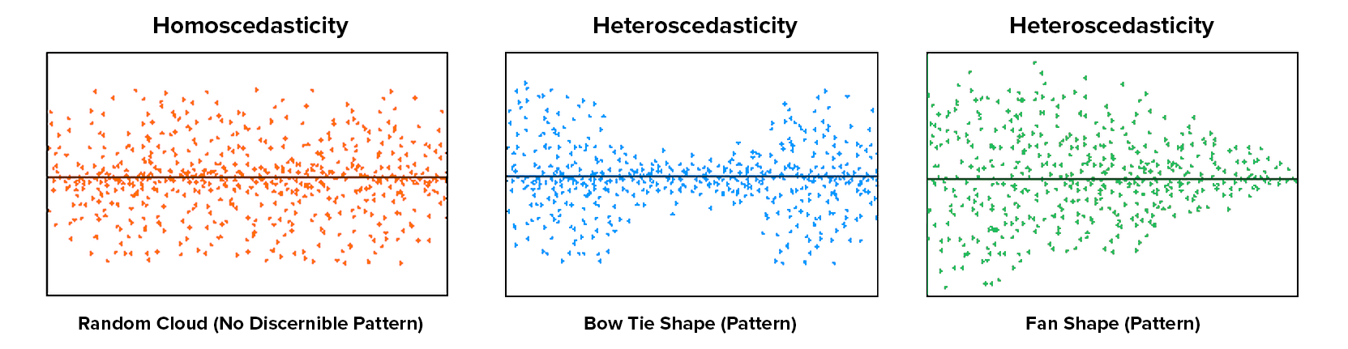
Assumptions of Linear Regression
Homoscedasticity Assumption
Homoscedasticity describes a situation in which the error term (that is, the “noise” or random disturbance in the relationship between the features and the target) is the same across all values of the independent variables
Notes:
The leftmost graph shows no definite pattern i.e constant variance among the residuals,the middle graph shows a specific pattern where the error increases and then decreases with the predicted values violating the constant variance rule and the rightmost graph also exhibits a specific pattern where the error decreases with the predicted values depicting heteroscedasticity

Slide 27
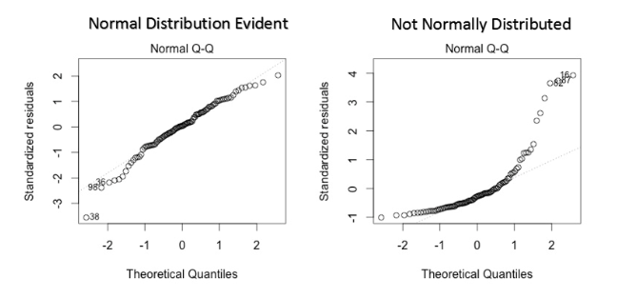
Assumptions of Linear Regression
Error terms are normally distributed with mean zero
The fourth assumption is that the error(residuals) follow a normal distribution. One particular repercussion of the error terms not being normally distributed is that the p-values obtained during the hypothesis test to determine the significance of the coefficients become unreliable.
Normal distribution of the residuals can be validated by plotting a q-q plot.
Notes:
However, a less widely known fact is that, as sample sizes increase, the normality assumption for the residuals is not needed. More precisely, if we consider repeated sampling from our population, for large sample sizes, the distribution (across repeated samples) of the ordinary least squares estimates of the regression coefficients follow a normal distribution. As a consequence, for moderate to large sample sizes, non-normality of residuals should not adversely affect the usual inferential procedures. This result is a consequence of an extremely important result in statistics, known as the central limit theorem.

Slide 28
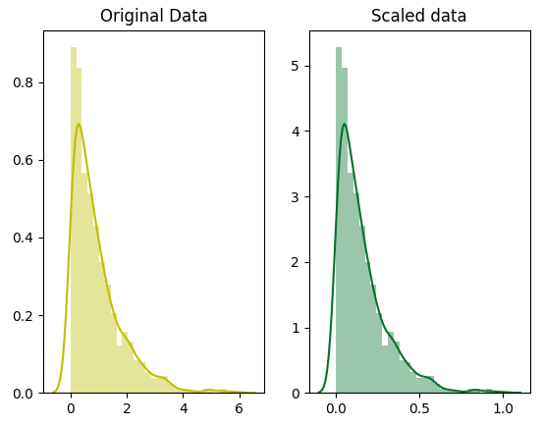
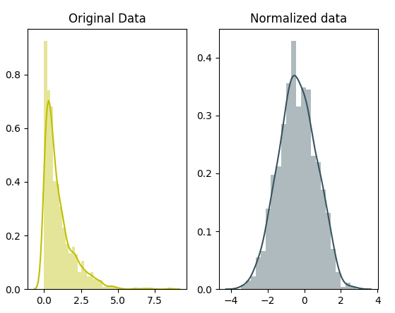
Scaling vs Standardization
Scaling (also called min-max scaling), you transform the data such that the features are within a specific range e.g. [0, 1].
Standardization (also called z-score normalization) transforms your data such that the resulting distribution has a mean of 0 and a standard deviation of 1
Scaling is important in the algorithms such as support vector machines (SVM) and k-nearest neighbors (KNN) where distance between the data points is important. For example, in the dataset containing prices of products; without scaling, SVM might treat 1 USD equivalent to 1 INR though 1 USD = 65 INR.
You need to normalize our data if you’re going use a machine learning or statistics technique that assumes that data is normally distributed e.g. t-tests, ANOVAs, linear regression, linear discriminant analysis (LDA) and Gaussian Naive Bayes.

Slide 29
#LifeKoKaroLift
Thank You!

